Slide 1
Analog & Digital Communication Systems
Week 3

Slide 2
Recap
Compression
Randomness, Redundancy, and Coding
Signal
System
Size of Signal
Energy
Power
Energy Signal
Power Signal
Suitable measures of Signals
Solved some examples

Slide 3





Example 2.2
(a)

Slide 4


Example 2.2
Remarks:
A sinusoid of amplitude C has power of regardless of its angular frequency and its phase.

Slide 5




Example 2.2

Slide 6




Example 2.2
We can extent this result to a sum of any number of sinusoids with distinct frequencies.

Slide 7





Example 2.2
Recall that
Therefore
The rms value is

Slide 8
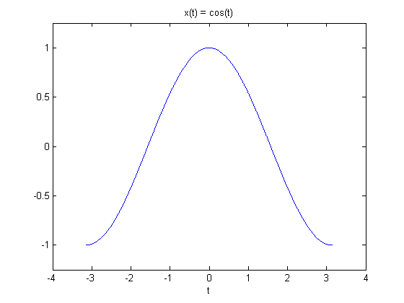
Classification of signals
Continuous-time Signal
A signal that is specified for every value of time t e.g. Audio and video signals

Slide 9
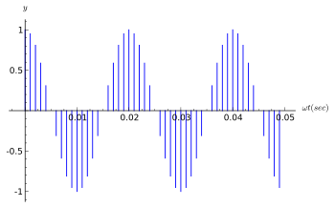
Classification of signals
Discrete-time signal
A signal that is specified for discrete value of time, e.g. Stock Market daily average

Slide 10
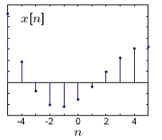
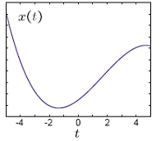
Classification of signals
Analog signal
Analog signal and continuous-time signal are two different signals
Analog signal whose amplitude can have any value over a continuous range
Analog continuous time signal x(t)
Analog discrete time signal x[n]

Slide 11
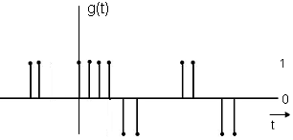
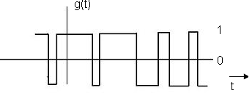
Classification of signals
Digital signal
Digital signal and discrete-time signal are two different signals
Discrete signal whose amplitude can have only a finite number of value
Digital continuous time signal
Digital discrete time signal

Slide 12
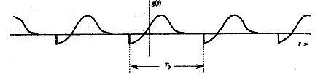
Classification of signals
Periodic signal
A signal g(t) is said to be periodic if there exist a positive constant T₀, such that
g(t) = g(t+T₀) for all t
Otherwise aperiodic signal

Slide 13

Classification of signals
Properties of Periodic Signal
By definition, a periodic signal g(t) remains unchanged when time-shifted by one period.
Thus, a periodic signal must start at time t = - because if it starts at some finite instant, say, t = 0, the time-shifted signal g(t+T) will start at t = -T, and g(t+T) no longer the same as g(t).
Therefore, a periodic signal, by definition, must start from - and continue forever.
Periodic signal shifted by integral multiple of T₀ remains unchanged
A periodic signal g(t) can be generated by periodic extension of any segment of g(t) with duration T₀

Slide 14
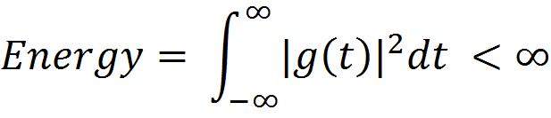
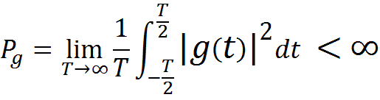
Classification of signals
Energy Signal
A signal with finite energy is called energy signal
Power Signal
A signal with finite power is called power signal

Slide 15
Classification of signals
Remarks:
A signal with finite energy has zero power.
A signal can be either energy signal or power signal, not both.
Every signal in daily life is energy signal, NOT power signal
Power signal in practice is not possible because of infinite duration and infinite energy

Slide 16
Classification of signals
Deterministic Signal:
A signal whose physical description is known completely, either mathematically or graphically is called deterministic signal
Random Signal:
A signal which is known in terms of probabilistic description such as mean value, mean squared value and distribution

Slide 17
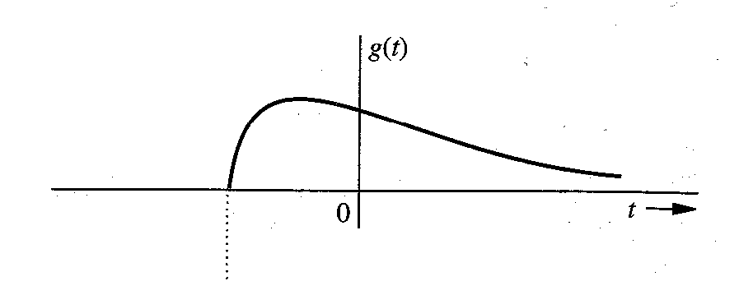
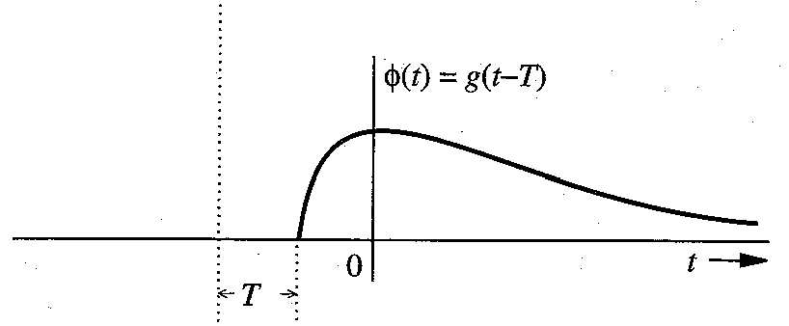
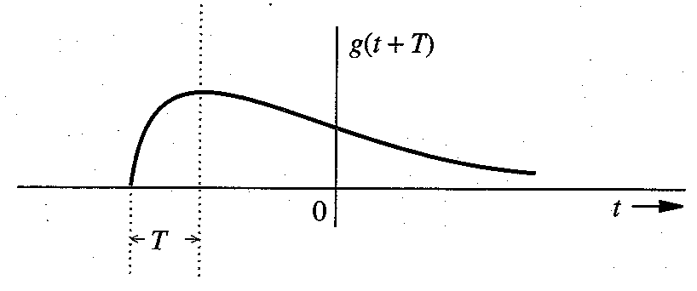
Signal Operation
Time Shifting
A signal g(t) is said to be time shifted if g(t) is delayed or advanced by time T
If signal g(t) is delayed by time T, then
If signal g(t) is advanced by time T, then

Slide 18
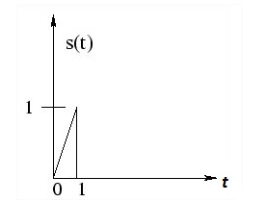
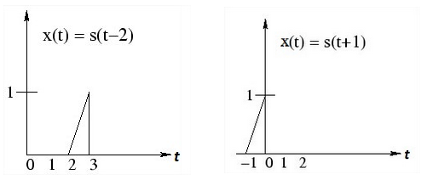
Signal Operation
Time Shifting
Find
x(t) = s(t - 2)
x(t) = s(t + 1)

Slide 19
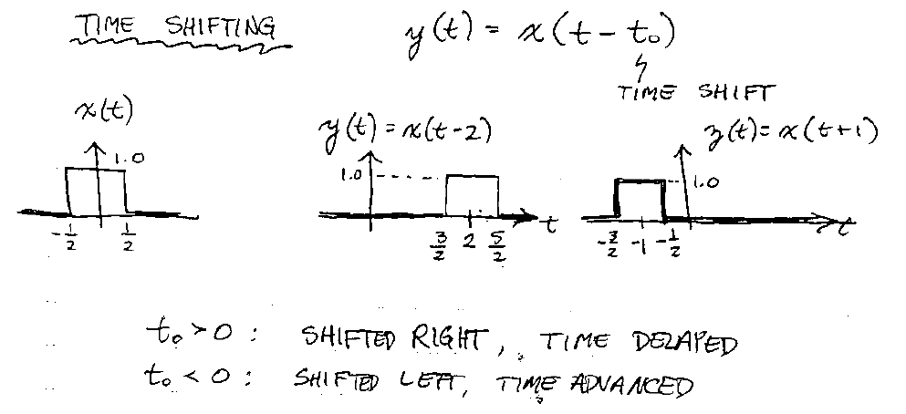
Signal Operation

Slide 20
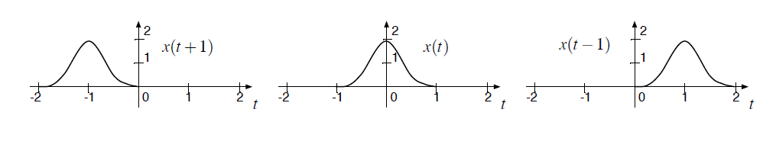
Signal Operation
Signal x(t) is given. Find x(t+1) and x(t-1)
x(t+1)
x(t-1)

Slide 21
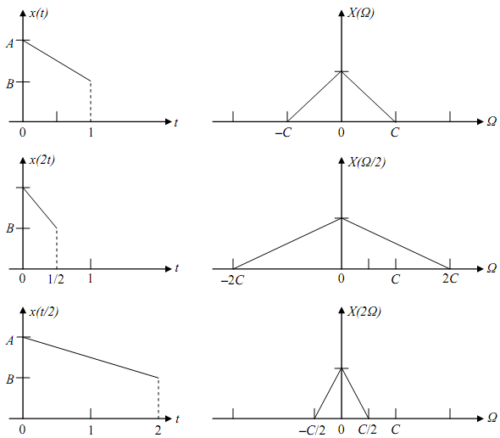
Signal Operation
Time Scaling
The compression or expansion of signal g(t) in time is known as Time Scaling
Compression
x(t)=g(at)
Expansion
x(t)=g(t/a)

Slide 22
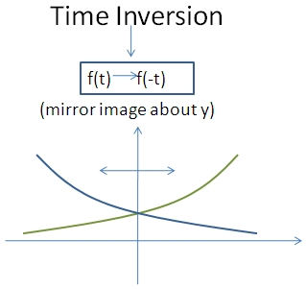
Signal Operation
Time Inversion
In time inversion, signal g(t) is multiplied by a factor a = -1 in time domain
g(t) = g(at) if a=1
Time inverted signal
g(-t) = g(at) if a=-1

Slide 23
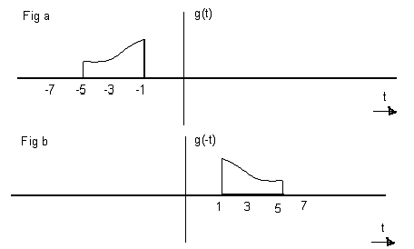
Signal Operation
Example: 2.4
For the signal g(t), shown in the Fig. below , sketch g(-t).

Slide 24
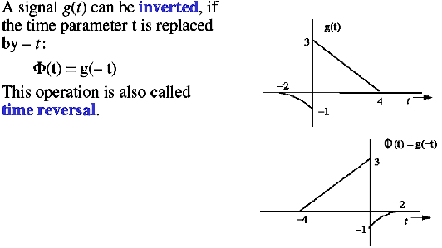
Signal Operations
Time- Inversion/ Time-Reversal (Folding)

Slide 25
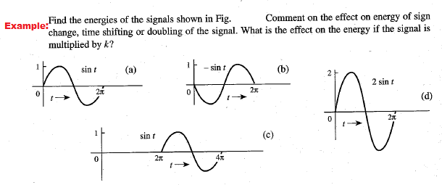
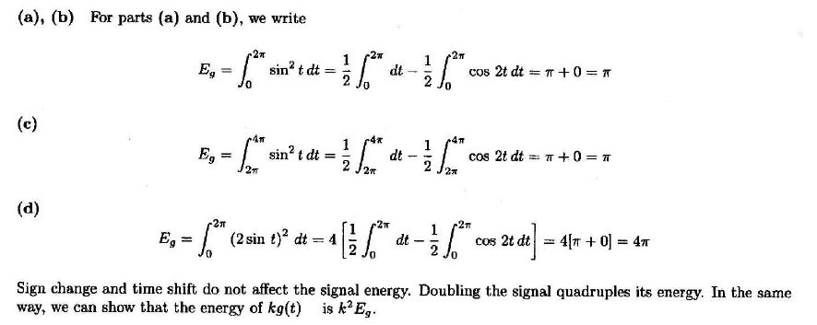
below

Slide 26

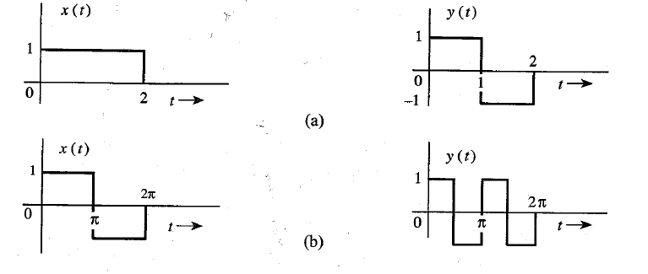
Signal energy Example

Slide 27
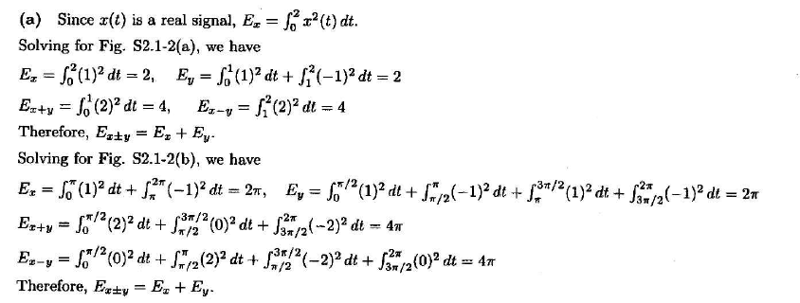
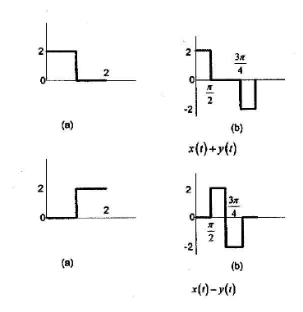
Solution
27

Slide 28
Summary
Power signal examples
Classification of signals
Continuous time and discrete time signals
Analog and digital signals
Periodic and aperiodic signals
Energy and power signals
Deterministic and probabilistic signals
Signals operations
Time shifting
Time scaling
Time inversion

Slide 29
Thank you

